Slide 1
Let’s Start

Slide 2
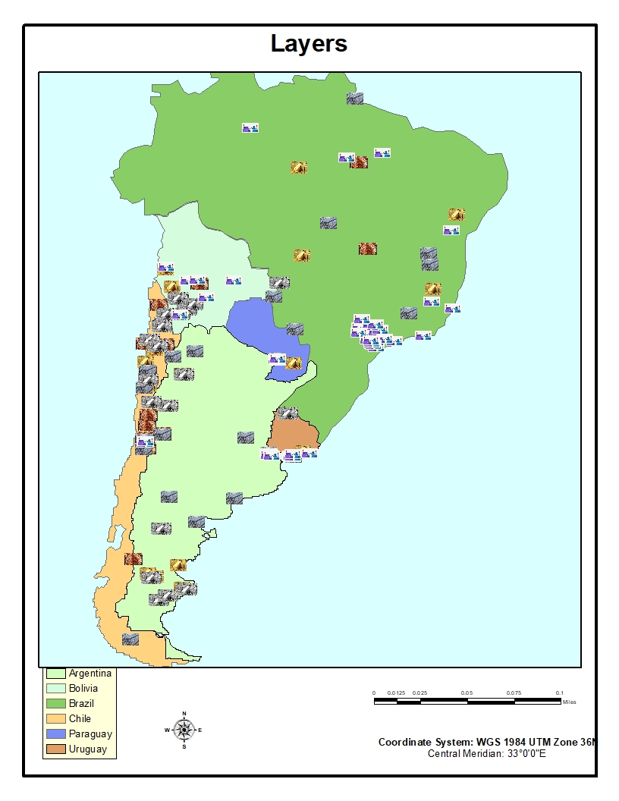
Total_Layout

Slide 3
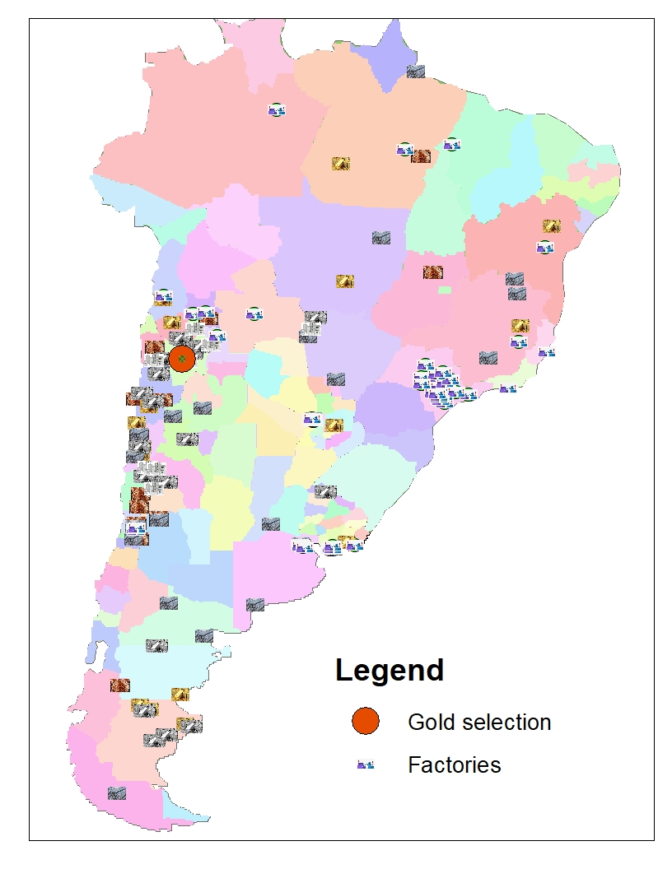
identical_fact_ gold
Location :
Spatial method :
Identical
Gold Iron Mine identical to a Factory of Gold

Slide 4
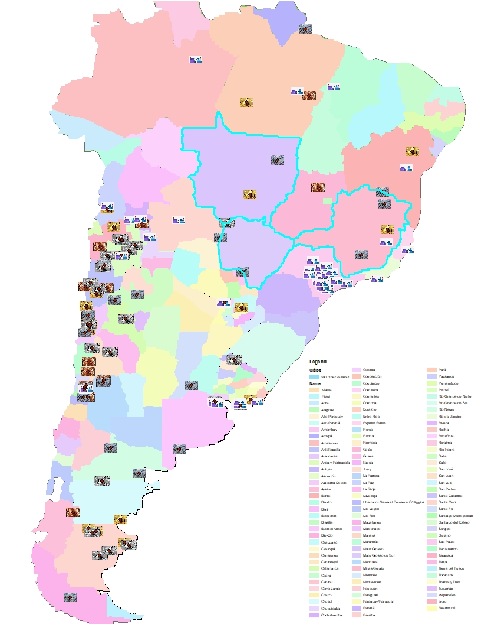
num mine_3_Brazil
Cities
Number of Mines > 3
Country Name =‘Brazil’

Slide 5
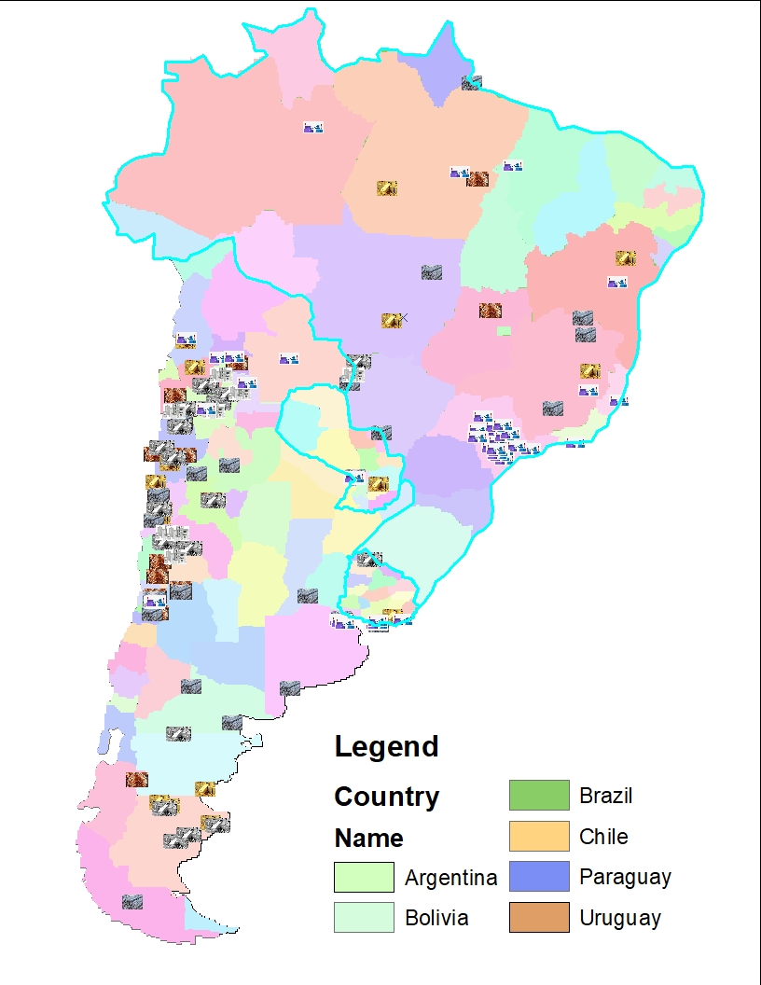
country_numfactory_10
Number of factoroies > 10

Slide 6
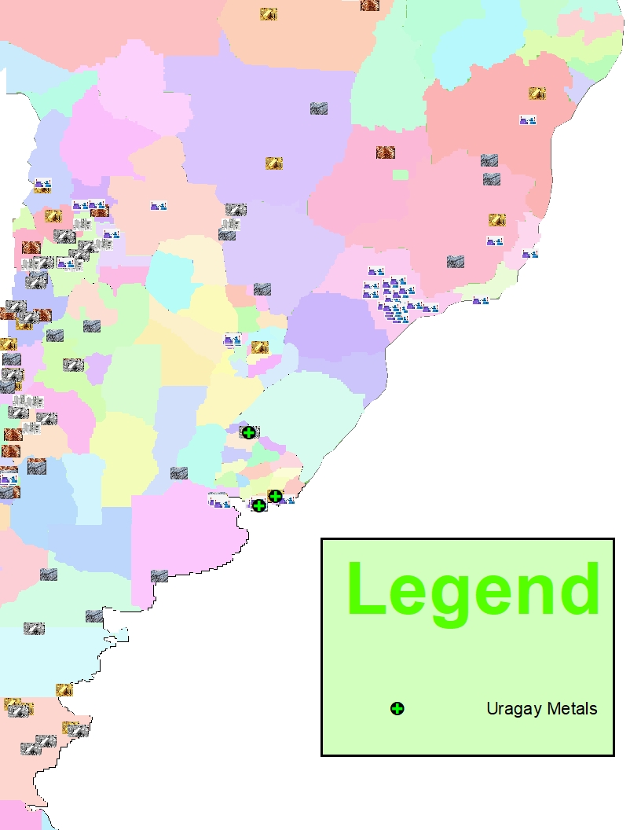
Uraguay Metal
Merge Tool :
Create new layer called: Metal cosists of (iron, Gold , Tin ,Copprer ,Silver)

Slide 7
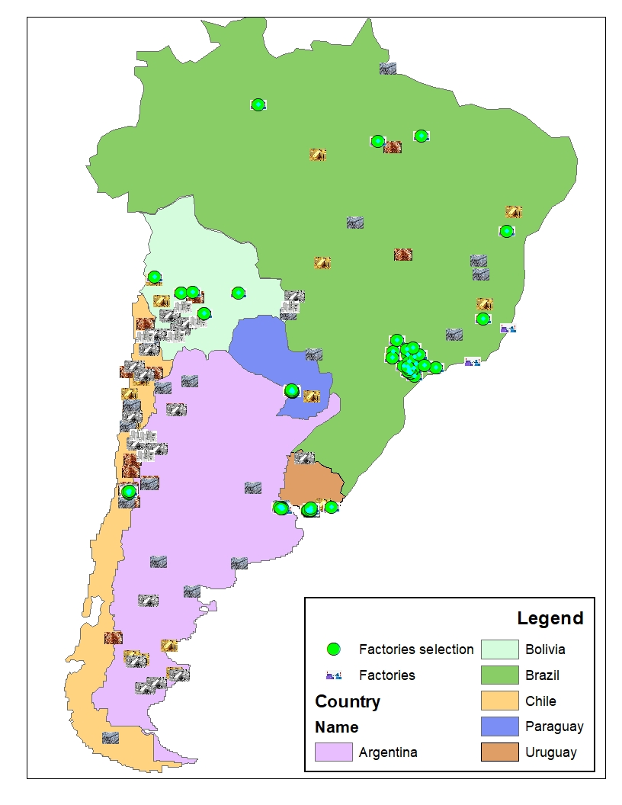
factory_country_ completely contain
Location :
Spatial method :
completely contain
All Factories in South America

Slide 8
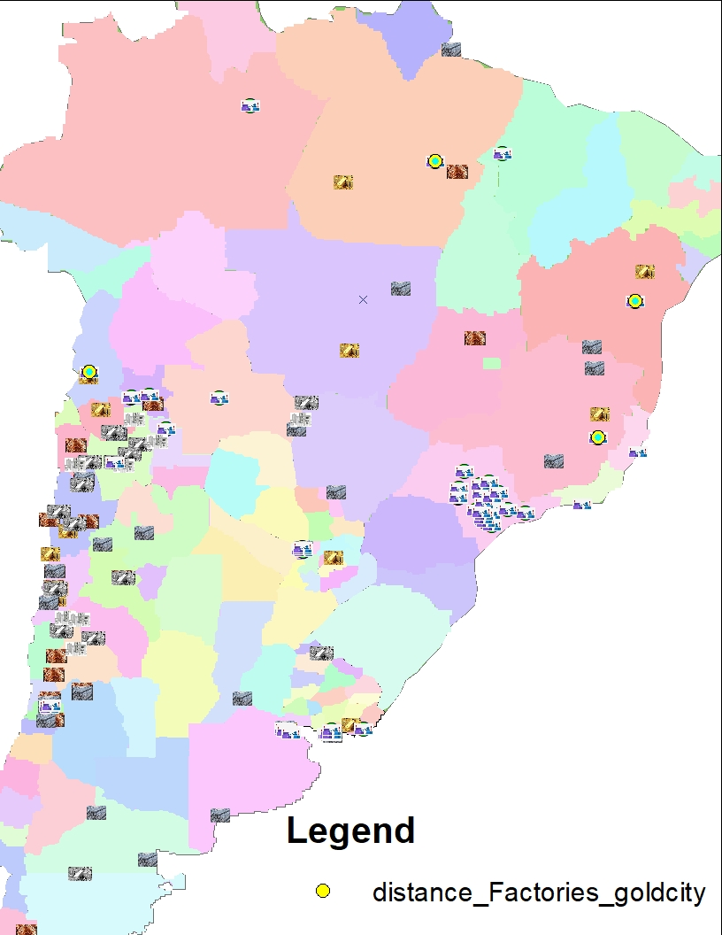
distance_factories_goldcity
target City - source : gold
With : contain (spatial method )
2-Location :
Factories : cityGold
Spatial Method : Withen Distance

Slide 9
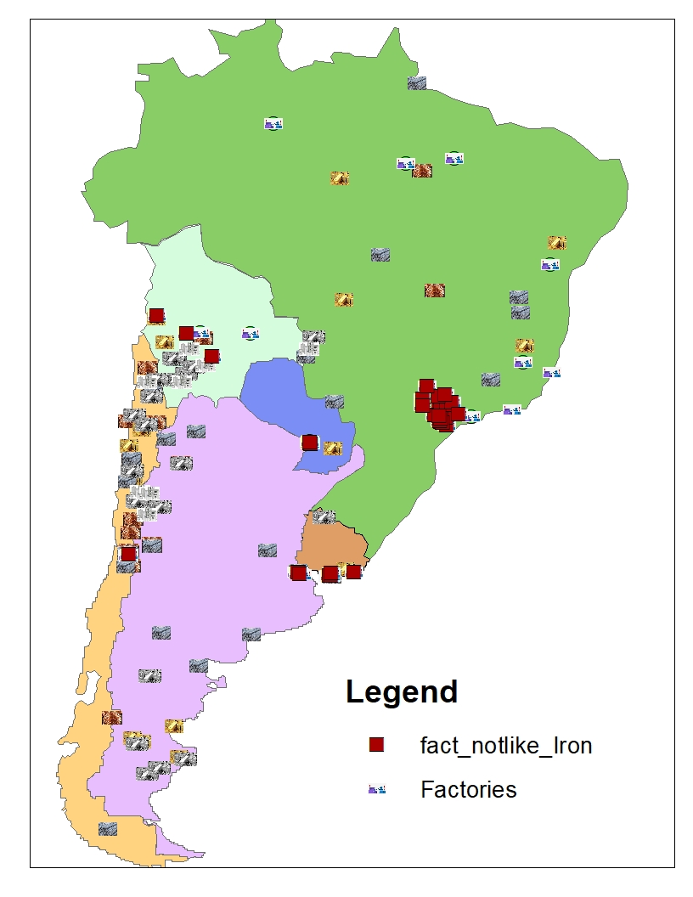
fact_notlike_Iron
Factories does not produce Iron Metal

Slide 10
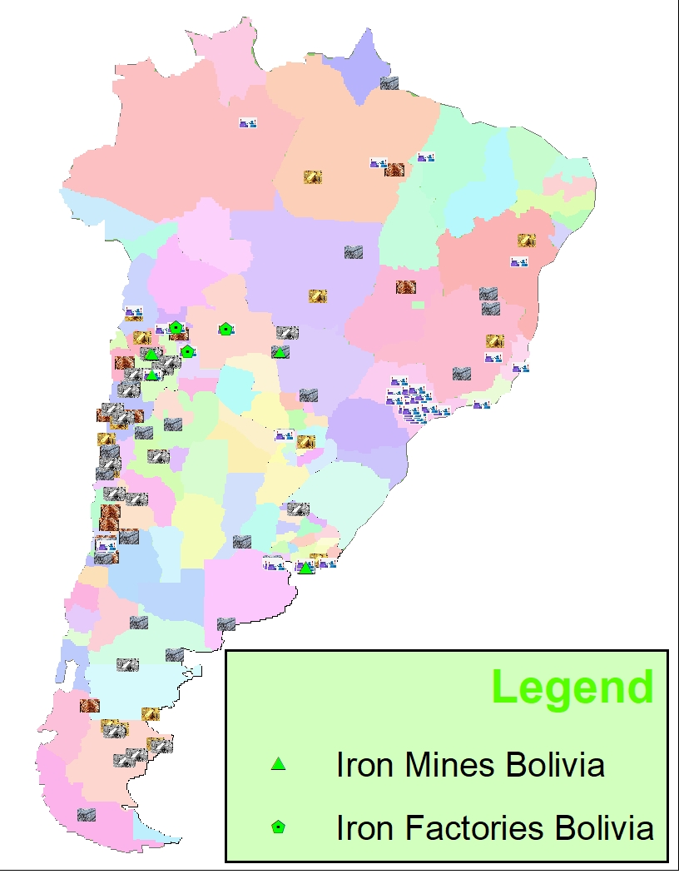
Mines and Factories in Bolivia
Iron Mines and Factories in Bolivia
With : Add to current selection
Notes:
Selection By Attribute
Method :Add to Current select
1-Select by Attribute
from iron :
Query : country name =blivia
from factories :
add to selected
select country name =boliva and type= iron.

Slide 11
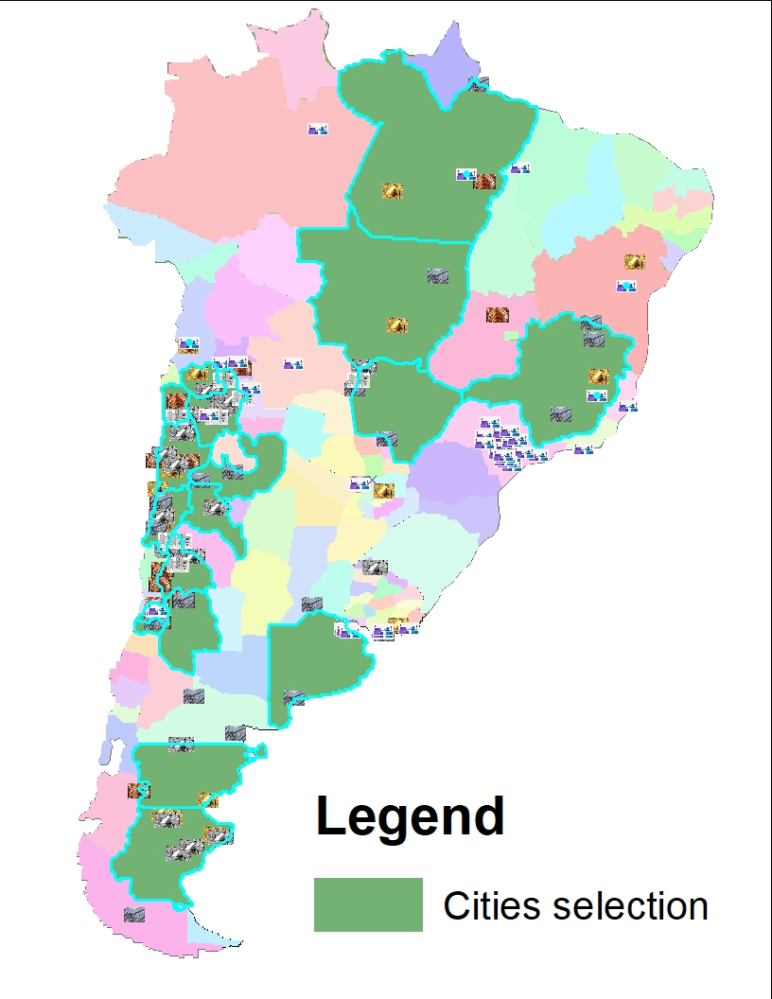
new_city_nummine_2
City (
Number of Mines >2)

Slide 12
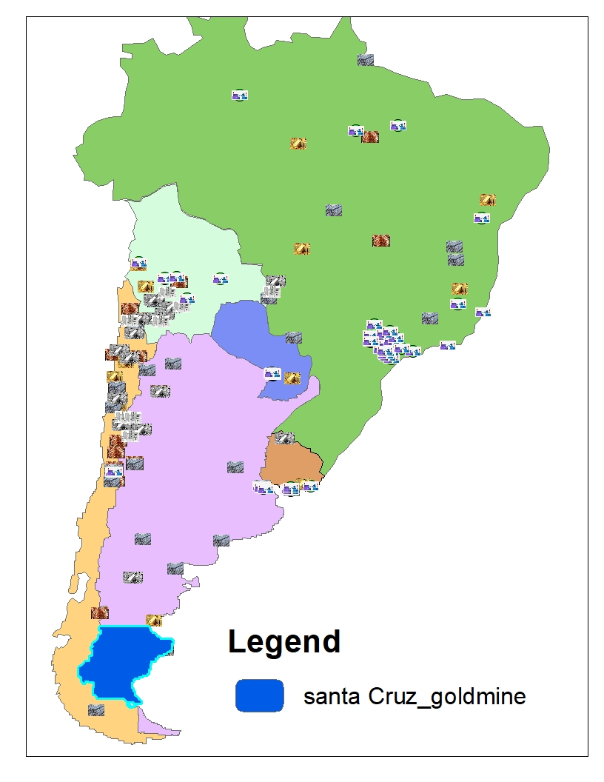
santa cruz
Location:
Cities : Gold
From new layer
Name of country = Santa Cruz

Slide 13
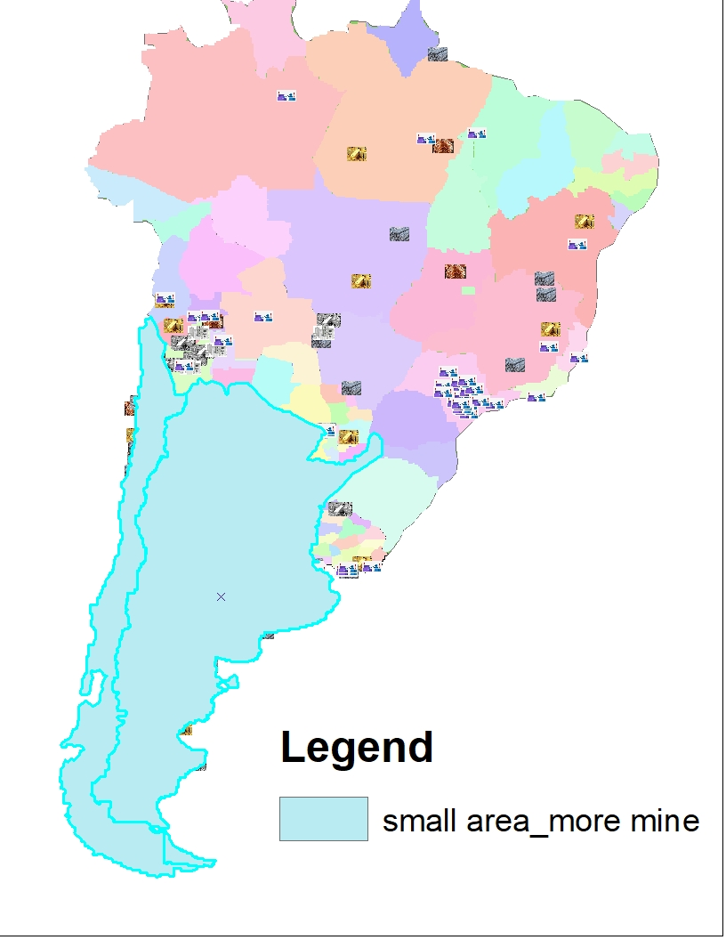
small area_more mine
Shape Area <=2023,00000
&&
Number of Mines >=20

Slide 14
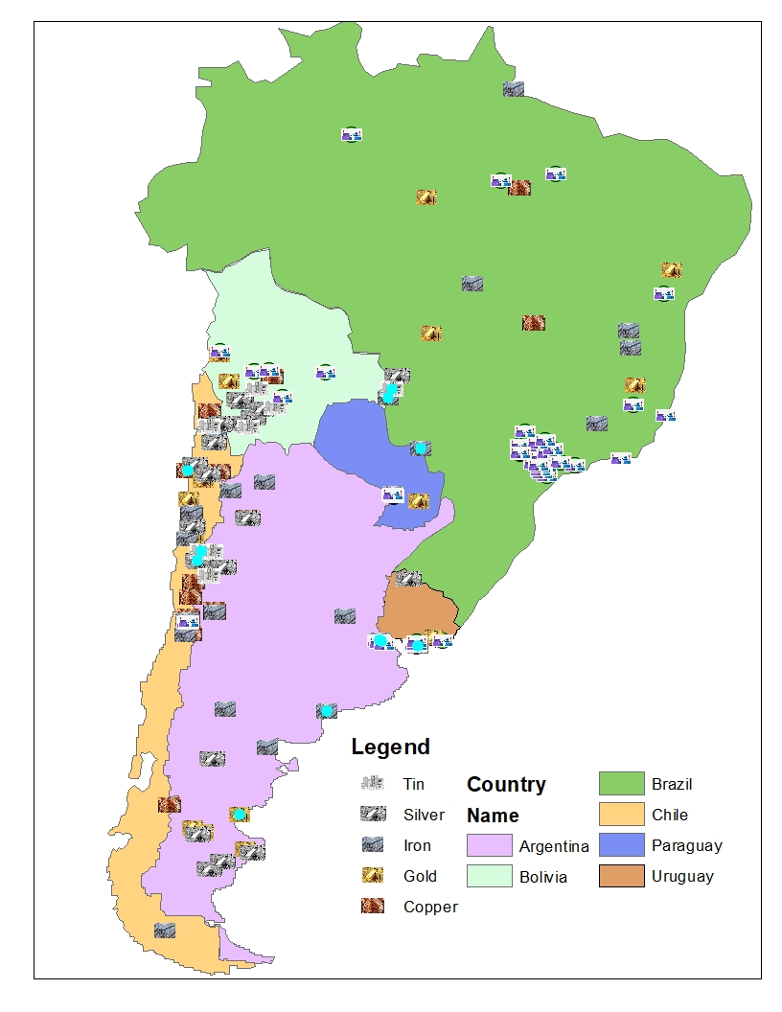
touch
Location :
Countries in Touch with Metals

Slide 15
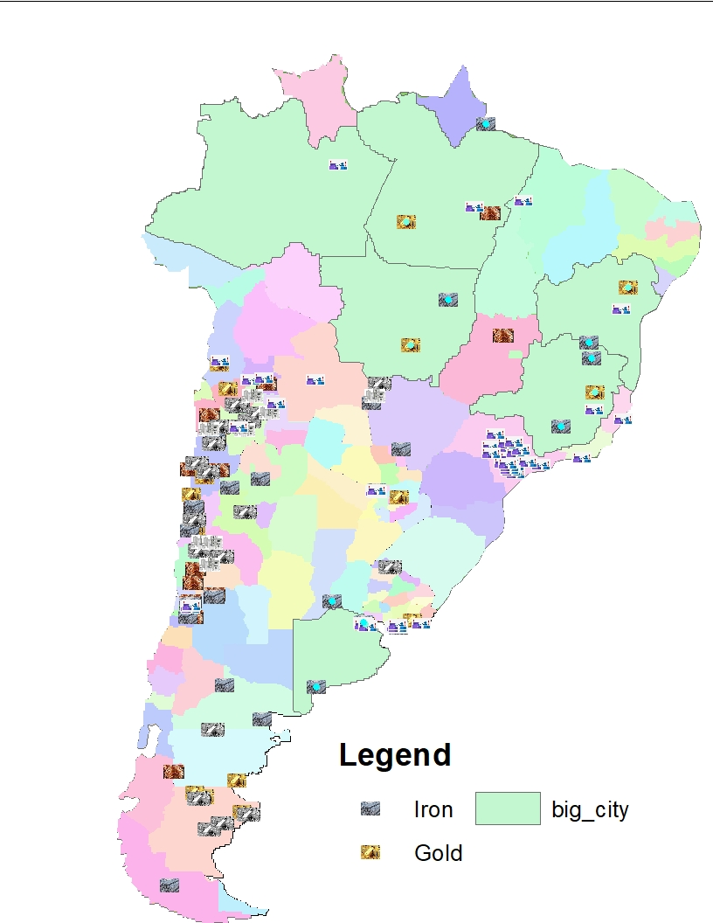
distance_Iron gold_ bigcity
City
Shape Area>2339,626460.
Location:
Selver, Iron : selected city
Spatial Method : within a distance
10,00

Slide 16
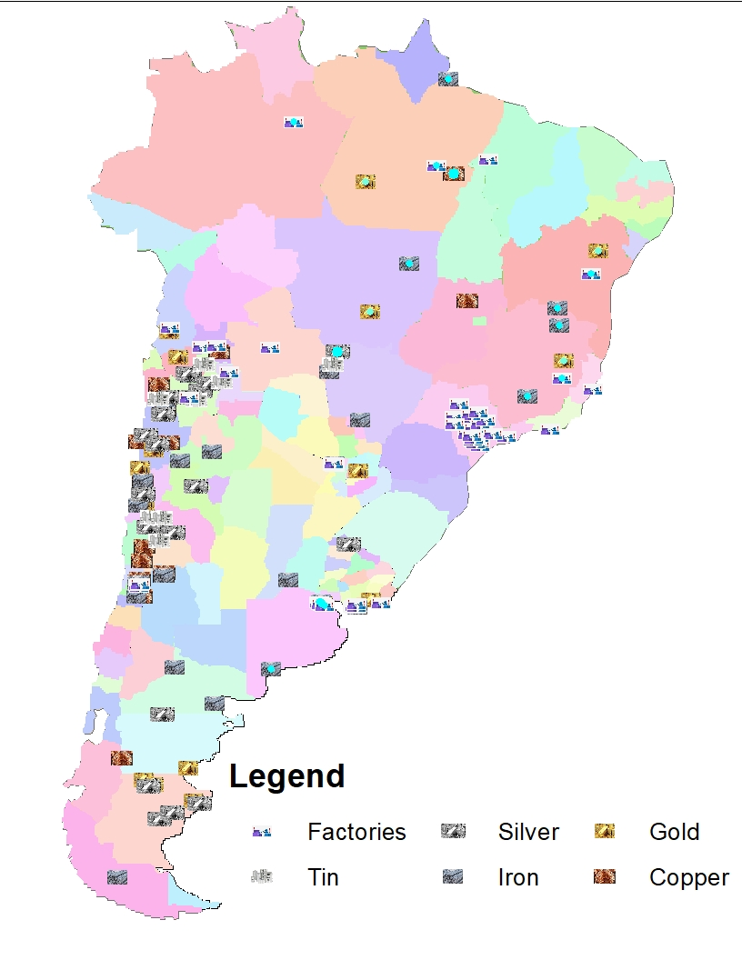
intersect_fact_Iron_Tin_Gold_Silver_Copper_with bigcity
From previous slide
Big city
Location :
Factories ,Tin,Silver ,Iron Gold ,Copper : Big_City
Spatial method : Intersect

Slide 17
Thanks …

